Slide 1
AngularJS：入門篇
開發技巧實戰系列(1/6) - Web 前端技術
講師: 郭二文 (erhwenkuo@gmail.com)
Notes:
開發技巧實戰
1. AngularJS入門篇
2. AngularJS + HighChart：完美網頁圖表整合篇
3. AngularJS + Asp.Net WebApi 2：前後端整合篇
4. AngularJS + Asp.Net WebApi 2+Entity Framework 6 (ORM)：前後端整合篇
5. AngularJS + Asp.Net WebApi 2+Entity Framework 6 (ORM) + Redis (Nosql)：前後端整合篇
6. AngularJS + Asp.Net WebApi 2+Entity Framework 6 (ORM) + Redis (Nosql) + Elasticsearch (全文檢索)：前後端整合篇

Slide 2
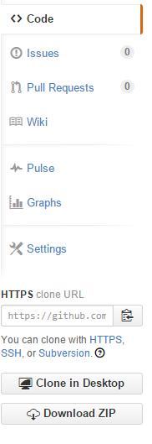
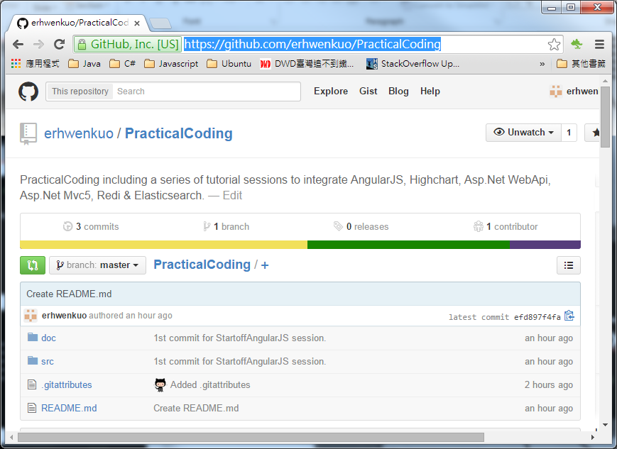

Document, Source code & Training Video
https://github.com/erhwenkuo/PracticalCoding

Slide 3


Document, Source code & Training Video
https://www.youtube.com/watch?v=Sr7PCDGfkic&feature=youtu.be
http://www.slideshare.net/erhwenkuo/01-startoff-angularjs

Slide 4
References
The training material of this session are base on Dan Wahlin’s terrific “AngularJS Fundamentals in 60-ish Minutes”
https://www.youtube.com/watch?v=i9MHigUZKEM

Slide 5
Agenda
AngularJS Introduction
Getting Started & Features
Directives, Filters and Data Binding
Views, Controllers and Scope
Modules, Routes and Factories
Notes:
The agenda is…
We’re going to start off with some of the key features AngularJS offers and I’ll kind of introduce the challenge with writing SPAs from scratch.
Anyone who knows me knows I do not recommend writing them from scratch. I just think that in the long term it is, when it comes to maintenance, a nightmare.
There’s too many scripts involved and I’m worried about version dependencies and scripts changing and things breaking.
So we’re going to talk about that and how Angular addresses it.
Then we’re going to get started with some of the framework fundamental features that Angular provides.
Then I’ll go into some of those key features that you’ve really got to start off with, kind of the A-B-Cs of Angular if you will, so Directives, Filters and two-way Data Binding which is just awesome.
I’m a big fan of some of the other scripts out there – like KnockoutJS as an example - but you’re going to see that Angular is a true framework. It’s not just a library that does maybe one or two things: it actually can do a LOT of different things.
Once we get through the Directives, Filters and Data Binding we’re going to talk about Views, Controllers and Scope.
And then we’ll wrap up with Modules, and we’ll talk about how all this other stuff fits into modules, and then we’ll get into some SPA concepts like Routes and even Factories for sharing data and using data.

Slide 6
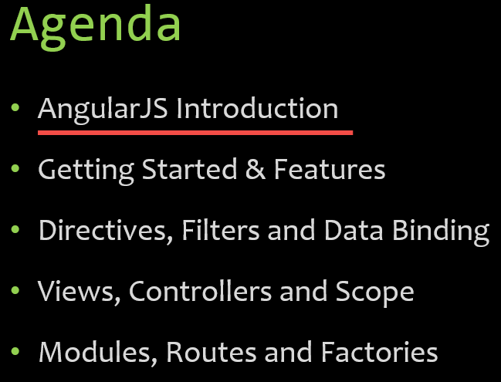
AngularJS Introduction

Slide 7
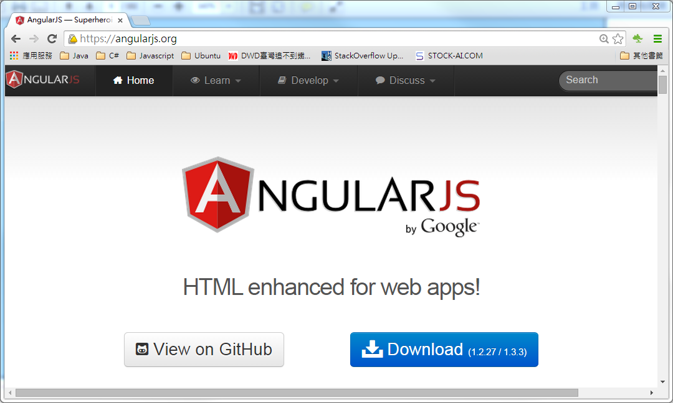
AngularJS Website
Http://angularjs.org
Notes:
1. 我們會100%著重在AngularJS
2. 在短短的一個半小時裡沒辦法把AngularJs的所有特色都詳細的介紹
3. 如果對AngularJs想要了解的更詳細的, 可以到AngularJs的網站。上面有詳細的文件, 範例及API講說。

Slide 8
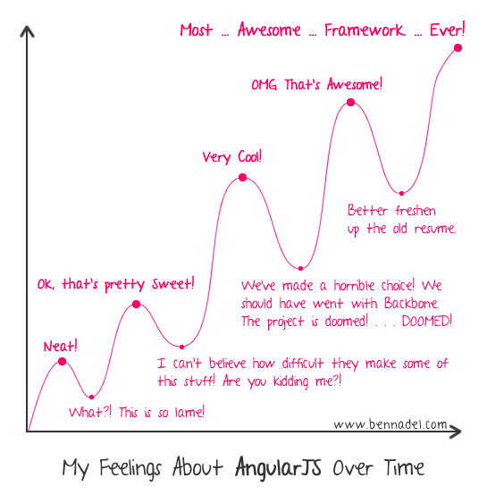
Feeling About AngularJS Over Time
Neat
→ What? This is so lame!
Ok, that’s pretty sweet!
→ I can’t believe how difficult they make some of this stuff! Are you kidding me?!
Very Cool!
→ We’ve made a horrible choice! We should went with Backbone.
OMG, that’s awesome!
→ Better freshen up the old resume.
Most awesome framework ever!
Notes:
網路上有一個人在他的Blog上post了一篇他學習AngularJS的感覺:
階段1: 這太棒了!
…靠! 這是啥東西呀!
階段2: 嗯~!不賴喔!
…機車! Google幹嘛把它搞的這麼複雜啦, 開啥玩笑, 這誰學的會!
階段3: 這東西實在是太酷了!
…完蛋了, 選AngularJS看來是選錯了, 我們應該會去用Backbone!!
階段4: 天啊, 這這這…不用它還有天理嗎!
…唉! 看來我還是不要在履歷表放AngularJS的經驗好了!
階段5: 這是有史以來最最最棒的Javascript框架了!

Slide 9

Feeling About AngularJS Over Time
Notes:
剛開始的時候, 你/妳可能會覺得很沮喪。
或許會覺得自己很笨, 怎麼都聽不懂或學不會。
其實最後你/妳會發現你只是想法上錯了, 或是不知道對的方法來學習它

Slide 10

Feeling About AngularJS Over Time
Notes:
累的時候, 放鬆一下。
待會兒再回來看的時候, 說不定你就會變成 “Wow~!這太棒了!”
AngularJS truly in my opinion is an awesome framework and so a lot of light bulbs went off. Once that started happening all the pieces fitted in and made total sense to me.
I think it’s like anything. With a new framework: sometimes you catch it instantly when you learn it, and other times you don’t.
What I’m going to do throughout this video is walk you through all the key things that I wish I would have understood more about upfront and hopefully jump-start your AngularJS development process.

Slide 11
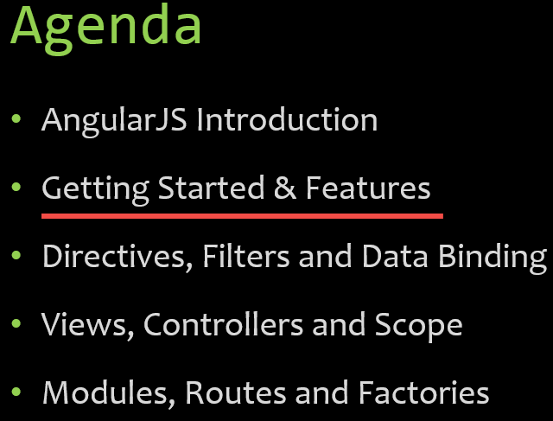
Getting Started & Features

Slide 12
Single Page Application (SPA)
Notes:
First off, a Single Page Application is one in which we have a shell page and we can load multiple views into that.
So a traditional app, as you know you typically blink and load everything again. It’s not very efficient on the bandwidth, especially in the mobile world.
In a SPA we can load the initial content upfront and then the different views or the little kind of mini- web pages can be loaded on the fly and embedded into the shell.
AngularJS, as we’re going to see, is a very good SPA framework, but it’s not just for that. You don’t have to load these dynamic views with it.

Slide 13

The Challenge with SPAs
DOM Manipulation
History
Module Loading
Routing
Object Modeling
Caching
Ajax/Promises
Data Binding
View Loading
Notes:
The challenge with building SPAs from scratch is there’s a lot of different issues to deal with: DOM manipulation and history and how do you dynamically load modules and how do you deal with promises when you make async calls and things like that.
Routing becomes a huge issue because you have to have some way to track “Where are we? And where are we going?”
All of this type of stuff you’re going to see is built into Angular. Now we can certainly do all this with different scripts out there. We could use sammyJS and jQuery and historyJS and requireJS. For AJAX we can use Q and there’s a lot of different options.
But Angular, you’re going to see, provides a lot of cool features.

Slide 14
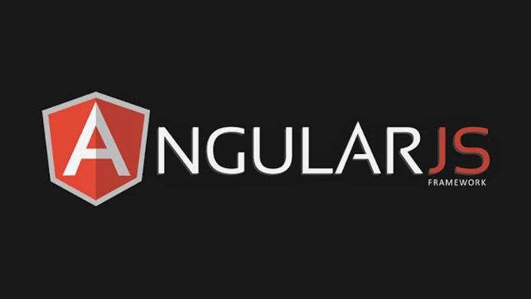
AngularJS is a full-featured SPA framework
Data Binding
MVC
Routing
Testing
jqLite
Templates
History
Factories
ViewModel
Controllers
Views
Directives
Services
Dependency Injection
Validation
Notes:
It does all kinds of good stuff.
We have two-way data binding. We have the Model-View-Controller concept. Routing of the Views I mentioned into the shell pages is done through built-in routing support and I’ll show how to do that in this video.
Testing was designed right from the beginning so you can build very robust tests if you’d like, which is obviously recommended.
For DOM manipulation jQLite is built-in which is kind of like the Mini-Me of jQuery.
If you want to use more advanced stuff you can even use jQuery and they play really nice together: Angular and jQuery.
When it comes to data binding we have full support for templates.
History’s built in.
We can share code through factories and services and other things.
Then there’s even more. We have the concept of data-binding with View Models.
Directives I’m going to be talking about in the next section, which is a way to teach HTML new tricks.
Validation.
Dynamically injecting different features at run time through dependency injection and much much more.

Slide 15
Developing Environment & Source Tree
Configure the Machine
Source Tree Folder Structure
.NET Framework 4.51
Visual Studio 2013 (Update 4)
doc : Contains documents related to the code base
lib : Contains all third-party and packages used by the application, including NuGet downloaded packages
src : Contains all the source code, including Visual Studio file(s) and all project folders
PracticalCoding
doc
lib
src
Notes:
為了降低學習上的困難, 在這一系列的課程中我們會使用Microsoft的Visual Studio 2013(Update 4)來做為開發的IDE

Slide 16
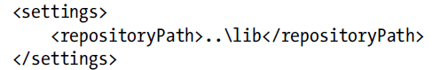
Developing Environment & Source Tree
Creating The Solution Folder Structure
PracticalCoding
Create a “Blank Solution” named “PracticalCoding” in Visual Studio
Close Visual Studio and copy “PracticalCoding.sln” to “src” folder
Delete the empty folder
Use text editor to create “nugget.config” file with below content under “src” folder
doc
lib
src
PracticalCoding.sln
Nugget.config
Notes:
為了降低學習上的困難, 在這一系列的課程中我們會使用Microsoft的Visual Studio 2013(Update 4)來做為開發的IDE

Slide 17
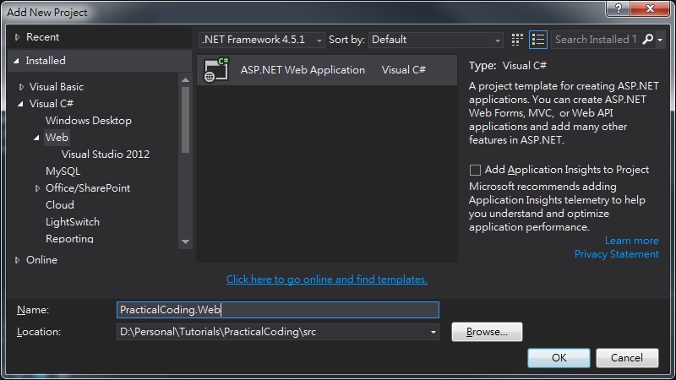
Developing Environment & Source Tree
Use File explorer to open “PracticalCoding.sln” file
Add new “ASP.NET Web Application” project under “PracticalCoding” solution in Visual Studio
Name this web project to “PracticalCoding.Web”
Click “OK”

Slide 18
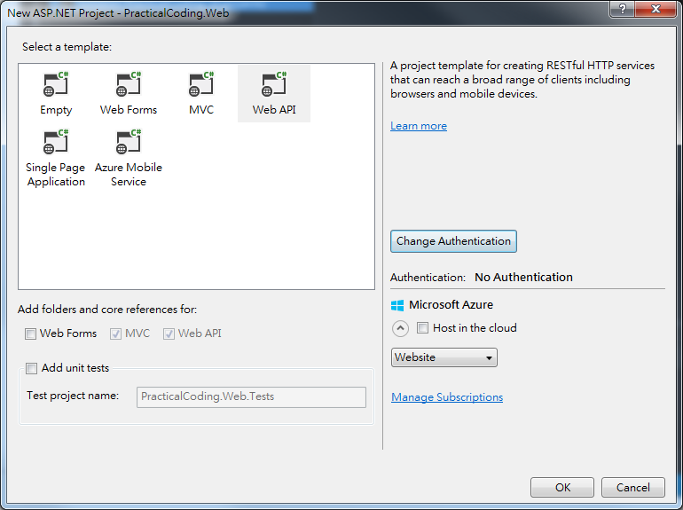
Developing Environment & Source Tree
Choose “Web API” template
Click “Change Authentication” to “No Authentication”
Click “OK”

Slide 19

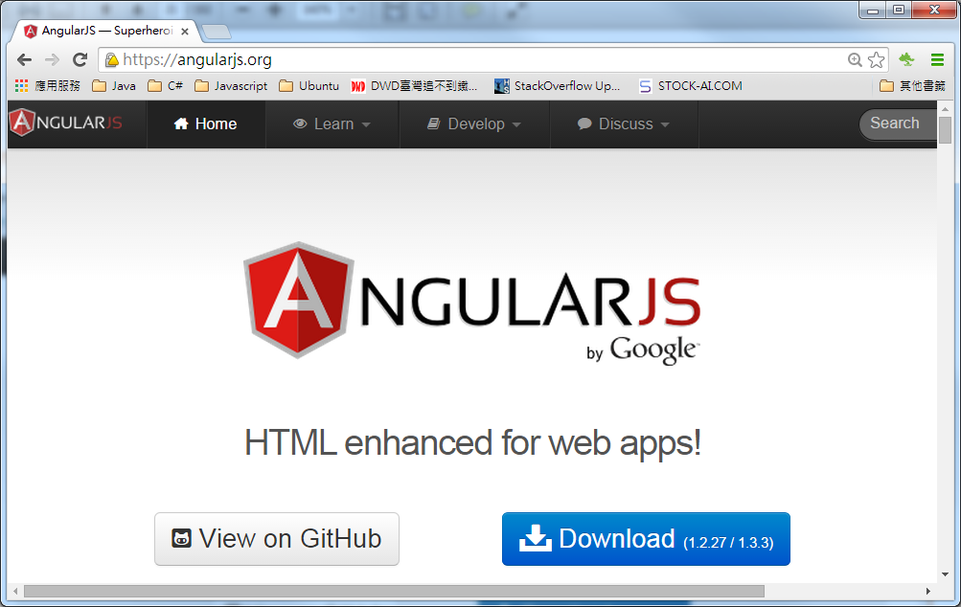

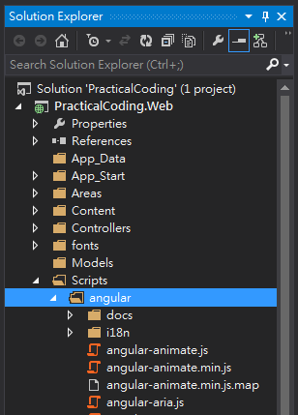

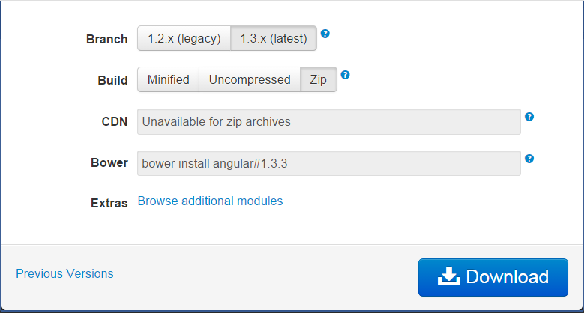

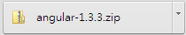
Developing Environment & Source Tree
Setup AngularJS
Download most update AngularJS from https://angularjs.org
Unzip and rename to “angular”
Copy and paste to C# project under “/Scripts” folder
Include the whole “/Scripts/angular” folder into C# project

Slide 20
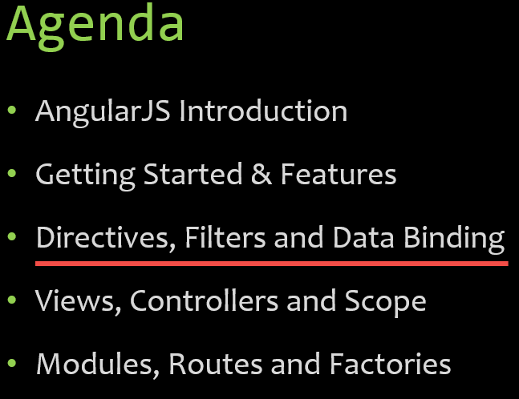
Directives, Filters and Data Binding

Slide 21


What are Directives?
They teach HTML new tricks!
Notes:
To start off, what is a directive?
Well I mentioned this earlier.
A directive is really a way to teach HTML new tricks.
The web when it first came out was really just designed to display static pages.
As we all know it’s become very dynamic and we’ve dealt with that pretty well.
jQuery came out many years ago and it provided a way to do it.
Even before then we could use raw, vanilla JavaScript.
Angular takes it up a whole notch and allows us to extend HTML very easily by simply adding attributes, elements or comments.

Slide 22
Using Directives and Data Binding Syntax
Notes:
Here’s an example of using a very basic, but important, Angular directive.
Notice at the top we have ng-app. Any time you see ng- that is an Angular directive. It’s a built-on directive. You can also write custom ones. You can get third party ones and things like that.
This particular directive is very important because the script that’s now loaded [at the bottom] is going to kick off and this will initialise the Angular app. Right now we don’t have any particular module associated or any other code but we can still do stuff just by adding ng-app.
So for example, this is an example of another directive called ng-model.
What ng-model does is behind the scenes it’s going to add a property up in the memory called “name” into what’s called “the scope”.
If you’ve ever dealt with the concept of a View’s model called a ViewModel - Knockout and some other libraries have this concept – then what this is really doing behind the scenes is making an empty ViewModel but then filling it with a name property. Now if I want to write out that value then I can simply come over and add a data binding expression.
Expressions are really cool because if I wanted to put “1 + 1” and try to write out the result I could do that. You can’t put conditional logic in here because you shouldn’t be putting that type of conditional logic in your views. But out of the box, just b
So let’s go ahead and look at a demonstration of that. y adding the ng-app and ng-model with a property as they type into this text box I can actually bind to that value and that provides a very cool little feature.

Slide 23
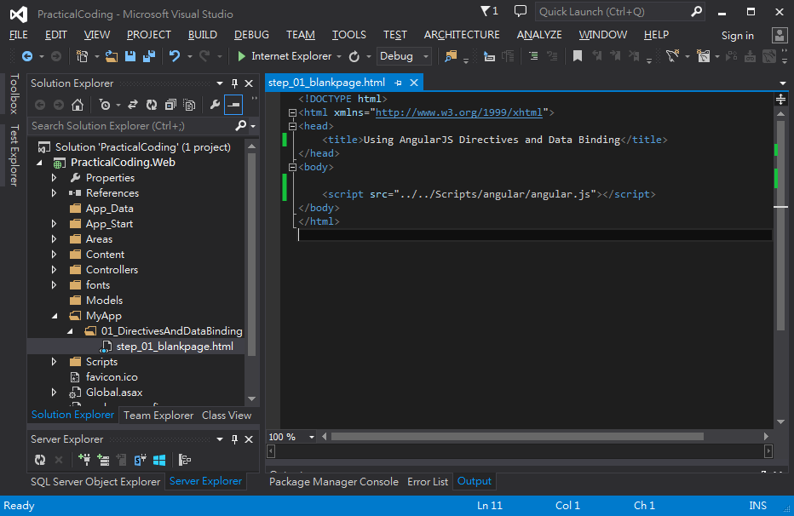
Using Directives and Data Binding Syntax (step_01_blankpage.html)
Demo Page
Create “MyApp” folder
Create “01_DirectivesAndDataBinding” folder under “MyApp”
Add new html file named “step_01_blankpage.html”
Drag “angular.js” from “Scripts” folder inside”<body></body>”

Slide 24
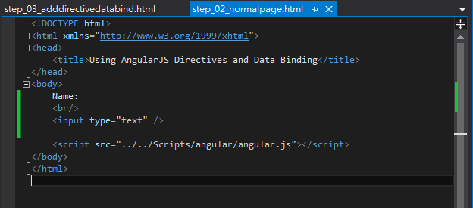
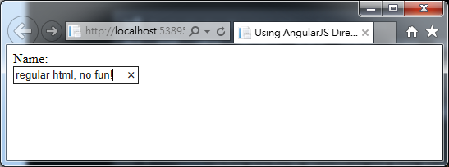
Using Directives and Data Binding Syntax (step_02_normalpage.html)
Demo Page
Copy “step_01_blankpage.html” as “step_02_normalpage.html
Add a simple html “input” tag
Hit “F5” and see the result

Slide 25
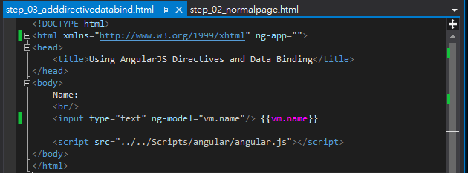
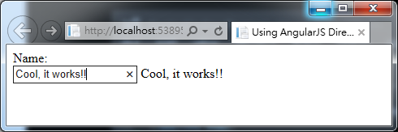
Using Directives and Data Binding Syntax (step_03_adddirectivedatabind.html)
Demo Page
Copy “step_02_normalpage.html” as “step_03_adddirectivedatabind.html ”
Add “ng-app” as attribute within “<html>” tag
Add “ng-model=‘vm.name’” within “<input>” tag
Add “{{vm.name}}” after “<input>” tage
Hit “F5” and see the result
Notes:
You can see that as I type it automatically binds it, and that’s pretty damned easy, right?
• Include the ng-app
• Include the ng-model
• Bind to that model.
This is pretty primitive and we’re going to go much deeper here, but that’s how we can get started.

Slide 26
Iterating with the ng-repeat Directive
“ng-init” is the angular directive to initialize some data
“ng-init” is the angular directive to iterate collection of data

Slide 27
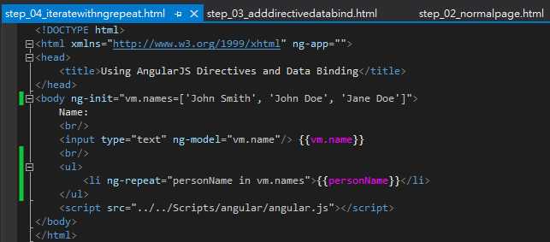
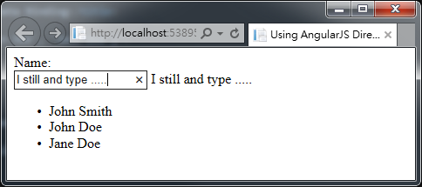
Iterating with the ng-repeat Directive(step_04_iteratewithngrepeat)
Demo Page
Copy “step_03_adddirectivedatabind.html” as “step_04_iteratewithngrepeat.html ”
Add “ng-init=….” as attribute in <body> tag and add “ng-repeat” as attribute in <li> tag.
Add angular expression “{{personName}} ” to show binding value
Hit “F5” and see the result

Slide 28
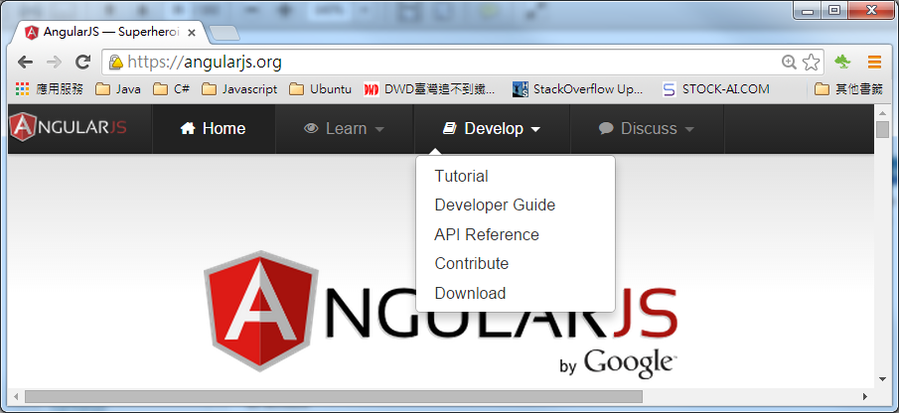
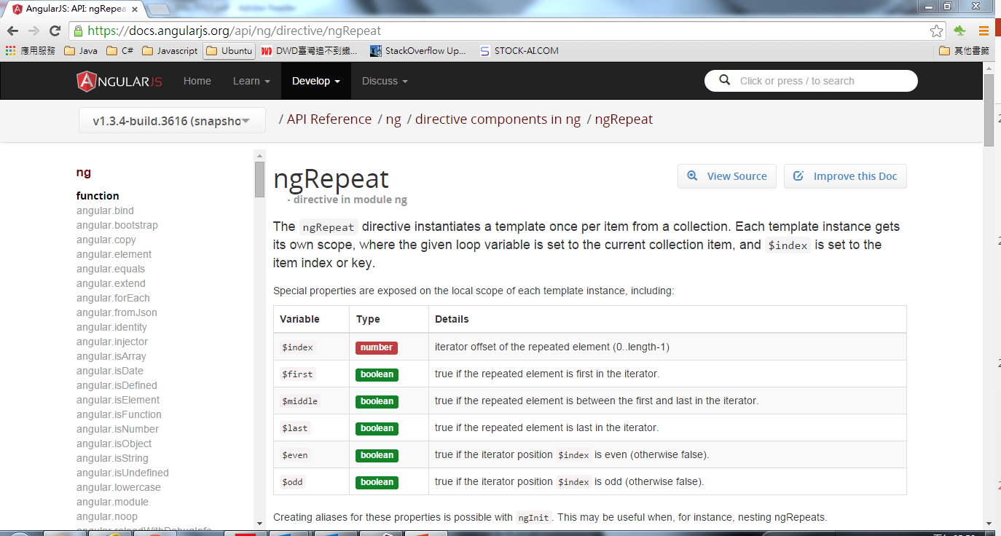
AngularJS Directives Document
Notes:
想了解AngularJS到底提供了多少的directives及它的用法。最好的方式就是到angularjs.org的網站上去看它的API 文件。
裡面不但包含了範例, 說明甚至連源始碼都可以在這裡頭找到。

Slide 29
Using Filters
Filter in AngularJS is not only used to filter data, but also it can be used to format data for display as well
Notes:
Let’s say that as we bind to, say a customer name, and we do that process we want to upper-case it. Now I could upper-case it in my data model, which we’ll get to in a little bit later, but an easy way to do this type of thing is to apply an AngularJS filter.

Slide 30
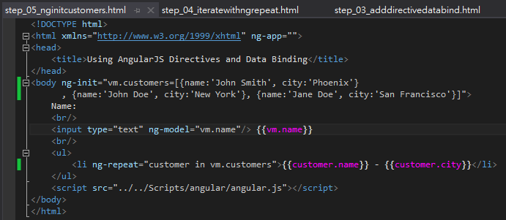
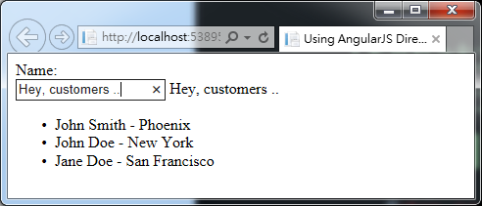
Iterating with the ng-repeat Directive(step_05_nginitcustomers)
Demo Page
Copy “step_04_iteratewithngrepeat.html ” as “step_05_nginitcustomers.html”
Change “ng-init=…. “ to initialize a array of Customer objects
Change “ng-repeat” to iterate this new customers collection. And Change angular expression “{{customer.name}} - “{{customer.city}} ” to show binding value
Hit “F5” and see the result

Slide 31
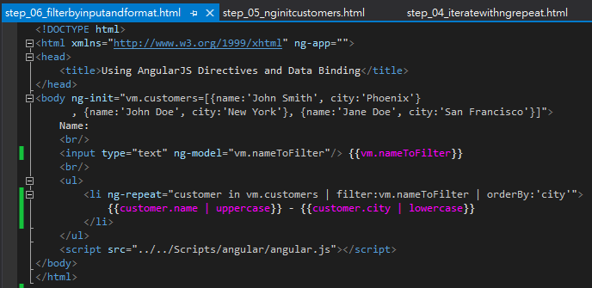
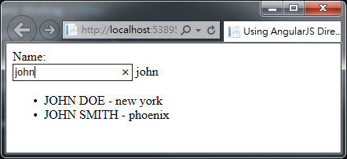

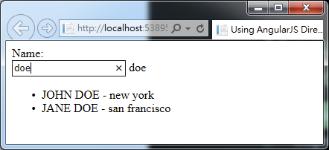
Iterating with the ng-repeat Directive(step_06_filterbyinputandformat)
Demo Page
Copy “step_05_nginitcustomers.html” as “step_06_filterbyinputandformat.html”

Slide 32
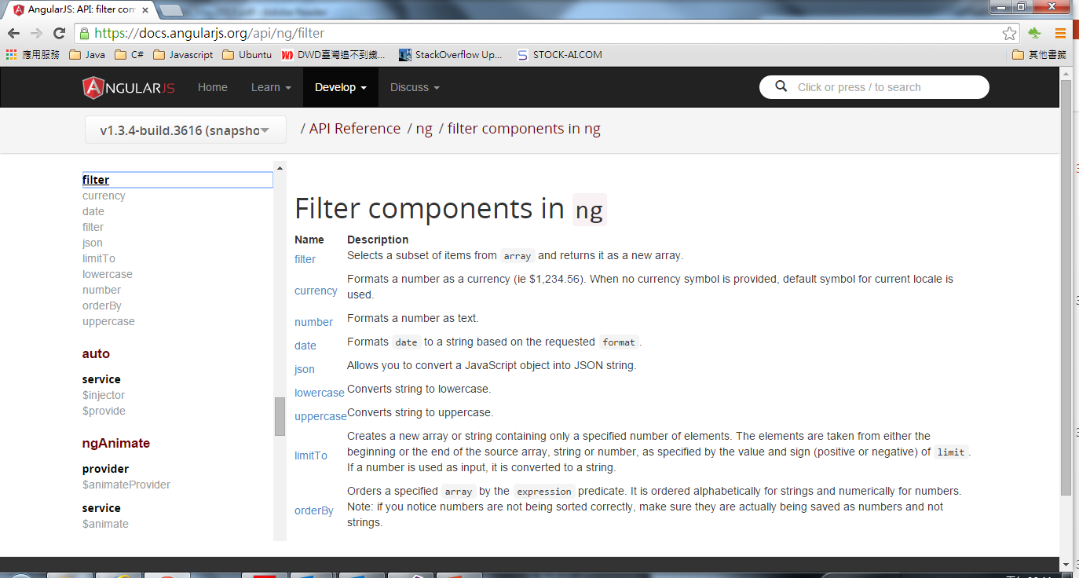
AngularJS Filter Component List

Slide 33
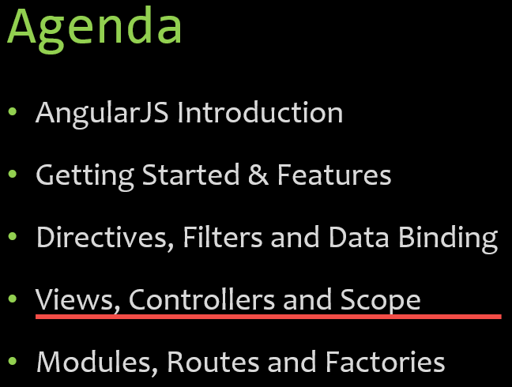
Views, Controllers and Scope
Notes:
In this part of the tutorial we’re going to talk about Views, Controllers and a really integral part of Angular called Scope, which is really another term for ViewModel if you’ve used that term before.

Slide 34

AngularJS View, Controllers & Scope
$scope is the “glue” (ViewModel) between a controller and a view
The view don’t have to know about the controller
The controller definitely doesn’t want to know about the view
$scope
View
Controller
Notes:
The way it works in Angular is you have a View, which is what we’ve been doing in the previous section with our Directives, our Filters and our Data Binding.
But we don’t want to put all of our logic into the View because it’s not very maintainable or testable or all those types of things.
Instead we’re going to have a special little JavaScript object – a container - called a Controller. The Controller will drive things. It’s going to control ultimately what data gets bound into the View. If the View passes up data to the controller it will handle passing off maybe to a service which then updates a back-end data store.
The glue between the View and the Controller is something called the Scope, and in Angular you’re going to see a lot of objects or variables that start with $. $scope represents the scope object.

Slide 35
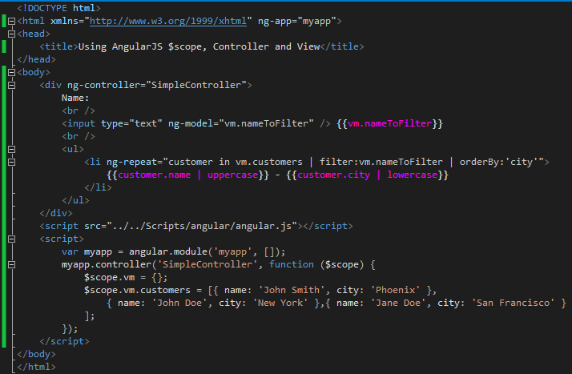
AngularJS View, Controllers & $scope(step_07_simplecontroller)
Demo Page
Copy “step_06_filterbyinputandformat.html” as “step_07_simplecontroller.html”
Assign view to specific controller
ng-repeat access the vm.customers via $scope
$scope is injected
Notes:
Here’s an example of a really simple controller called, oddly enough, SimpleController. You’ll notice an interesting thing here in the parameter signature. You’ll see that we pass $scope. This is dependency injection that’s built into AngularJS

Slide 36
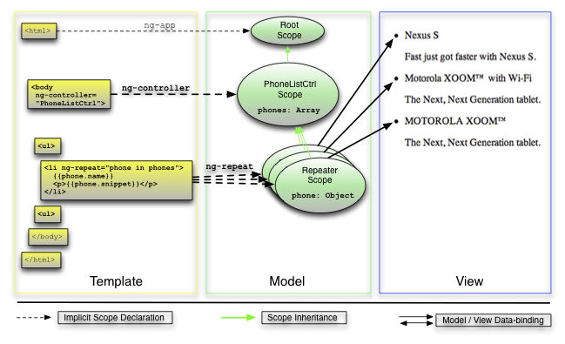
AngularJS View, Controllers & $scope
Notes:
The way it works in Angular is you have a View, which is what we’ve been doing in the previous section with our Directives, our Filters and our Data Binding.
But we don’t want to put all of our logic into the View because it’s not very maintainable or testable or all those types of things.
Instead we’re going to have a special little JavaScript object – a container - called a Controller. The Controller will drive things. It’s going to control ultimately what data gets bound into the View. If the View passes up data to the controller it will handle passing off maybe to a service which then updates a back-end data store.
The glue between the View and the Controller is something called the Scope, and in Angular you’re going to see a lot of objects or variables that start with $. $scope represents the scope object.

Slide 37
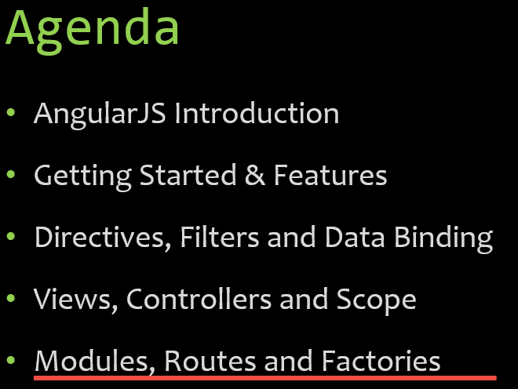
Modules, Routes and Factories
Notes:
Now that you’ve seen data binding, directives, filters and controllers, and you’ve seen how the scope actually can integrate between a view and a controller it’s now time to really move it up a notch and talk about modularity and some more SPA-oriented concepts like routes.
In this section we’re going to talk about how to create modules, and how modules can actually be used to create other things like controllers, routes, factories and services, and how all this fits together.

Slide 38
AngularJS Architecture (Simplified)
Module
Config
Routes
View
$scope
Controller
Directives
Factory
Notes:
當我開始學習AngularJS的時候, 曾經有一度我覺得相當掙扎，後來歸咎原因, 最主要是我沒有一開始就先對Angular的結構及它相關的元件是如何相互協同運作的部份做一個整體的了解。
在這裡我會秀出一個AngularJS結構的簡圖, 當然它有可能太過於簡化AngularJS了, 但是它讓我可以快速的理解AngularJS。
一個AngularJS的模組(Module)可以呼叫一個config的function。
It can be defined to use different routes. Now routes again are really important in the SPA world because if you have different views and those views need to be loaded into the shell page then we need a way to be able to track what route we’re on and what view that’s associated with and then what controller goes with that view and how we do all of that marrying together of these different pieces.
When you define a route in AngularJS you can define two things on that route – two of the key things, I should say.
One of those is the view. So what view when that route such as “unit.org/orders” then maybe go to “orderspartial.html” or “ordersfragment.html” or whatever you want to call it.
Then that view needs a controller. Instead of hard-coding the controller into the view – which works and you can certainly do it: I showed that in the previous section – we can actually go in and do this on our own through the route. This is the way I would definitely recommend you do it.
A given controller would then of course have access to the scope object which then the view will bind to. I talked about that a little bit earlier.
And then controllers rather than having all the functionality to get the data and update the data and perform CRUD operations and things like that, in a more real life application they’ll call out to factories or… I put a star there because you might have services, providers or even values you want to get. There are a lot of different ways you can access data. Even resources.
On the views we of course then have directives and filters and those types of things.
There’s even more to the overall picture but this is one of those things I wish I would’ve seen this right upfront because I would have kind of instantly had that light bulb moment where the light goes on and you say “OK. So you define a route, a route has a controller and a view and then the controller can load data from factories and services and things.”
What we’re going to do is talk about each of these individual pieces and how in a single page application you can actually define routes and use those.

Slide 39
Modules are Containers
Module
Config
Filter
Directives
Factory
Controller
Service
Routes
Provider
Value

Slide 40
Creating AngularJS Module & Controller

Slide 41
AngularJS Module and Controllers (step_07_simplecontroller)
Demo Page
step_07_simplecontroller.html
Assign view to specific controller
$scope is injected
Notes:
Here’s an example of a really simple controller called, oddly enough, SimpleController. You’ll notice an interesting thing here in the parameter signature. You’ll see that we pass $scope. This is dependency injection that’s built into AngularJS

Slide 42
The Role of Routes
Notes:
Now once you’ve defined a module and a controller, at some point if you’re building a single page application you’re going to need routes because we need to load different views into our shell page.
This will be an example of four different routes.
We have when View1 is clicked maybe there’s a link to it and that link is something like “/view1”. Typically you have a hash but you’ll see that coming up. That will load that view. Then when they click on a link that has View2 in the path then that would load up View2 but it’s not going to load up the whole shell page. Angular will only load up the page that you want.
There’s two kind of ways you can load it.
First off, the view could be embedded as a script template in the actual shell page and then we could just tell Angular “Heh! The template id to load… it’s kinda like saying ‘The view id is x’”.
The second way is back up on the server you might actually have all these Views and I like to call them “partials” because they’re part of a page. You can tell Angular “the template URL for what I want to load” and then you give it the URL to the server, and I’m going to show that coming up here.

Slide 43
Defining Routes
Notes:
This is a really important feature because we want to be able to go in and load different partials or fragments and then that will be kind of how our SPA works.
What we’re going to do is use that config that I showed earlier.
We have angular.module is “demoApp” with no dependencies.
Now what I’m going to do is configure the module with some routes. Another object that’s available in Angular is called the routeProvider, as you can see here. It’s kind of like the scope – it’s injected in dynamically just by defining $routeProvider as your parameter.
In this case we’re going to say “For the routeProvider when the route is just a slash “/” to the root we want to use SimpleController with View1.html. When the route is “/partial2” we want to use the same controller in this case but you can certainly do a different one, with a template URL of View2.
Now the template URL: you might give it a folder where these partials are going to live, and I actually like to call my folder “partials” but you don’t have to.
Otherwise if it [the route] doesn’t mean any of those routes we’re going to redirect back to the root, which ultimately goes back up to here [the “/” route specified with the first “.when” statement] which will load View1.

Slide 44
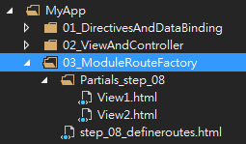
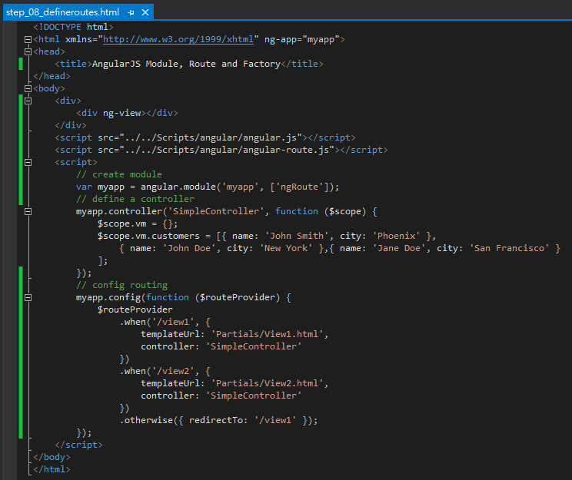
AngularJS Define Routes Demo (step_08_defineroutes)
Demo Page
Copy “step_07_simplecontroller.html” as “step_08_defineroutes.html”
Add one <div> with “ng-view” inside
Include “angular-route.js”
Using “$routeProvider” to define routes
Notes:
Here’s an example of a really simple controller called, oddly enough, SimpleController. You’ll notice an interesting thing here in the parameter signature. You’ll see that we pass $scope. This is dependency injection that’s built into AngularJS

Slide 45
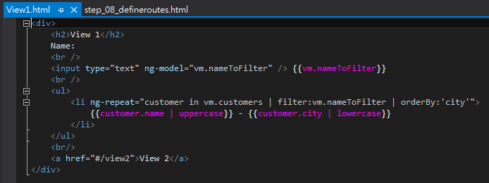
AngularJS Define Routes Demo (step_08_defineroutes)
Demo Page
Create “View1.html” under folder “Partials_step_08”
Notes:
Here’s an example of a really simple controller called, oddly enough, SimpleController. You’ll notice an interesting thing here in the parameter signature. You’ll see that we pass $scope. This is dependency injection that’s built into AngularJS

Slide 46
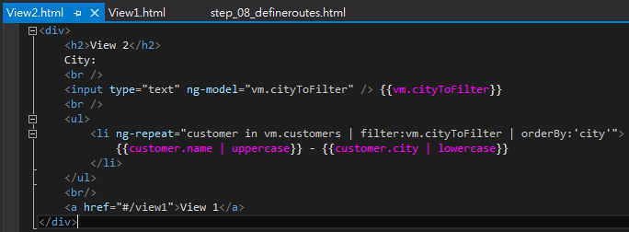
AngularJS Define Routes Demo (step_08_defineroutes)
Demo Page
Create “View2.html” under folder “Partials_step_08”

Slide 47
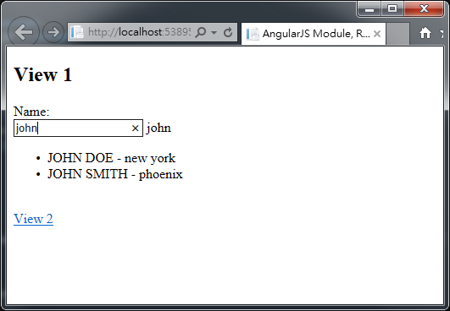
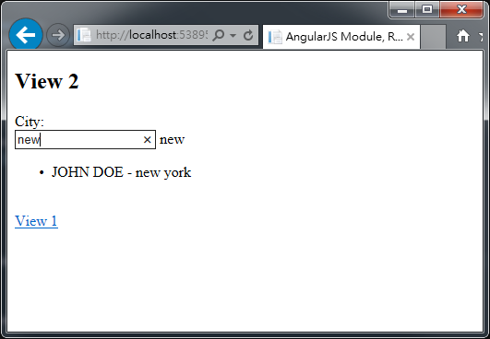
AngularJS Define Routes Demo (step_08_defineroutes)
Demo Page
Select “step_08_defineroutes.html” and Hit “F5” to run

Slide 48
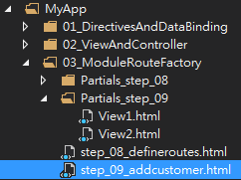
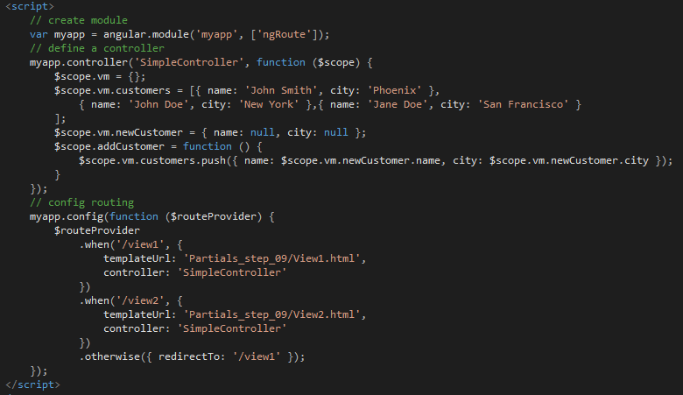
AngularJS Define Routes Demo (step_09_addcustomer)
Demo Page
Copy “step_08_defineroutes.html” as “step_09_addcustomer.html”
Add a new method “addCustomer()” under “SimpleController”
Create a new variable for newCustomer
Define routings
Create a new variable for newCustomer
Notes:
Here’s an example of a really simple controller called, oddly enough, SimpleController. You’ll notice an interesting thing here in the parameter signature. You’ll see that we pass $scope. This is dependency injection that’s built into AngularJS

Slide 49
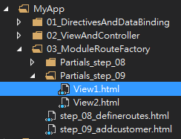
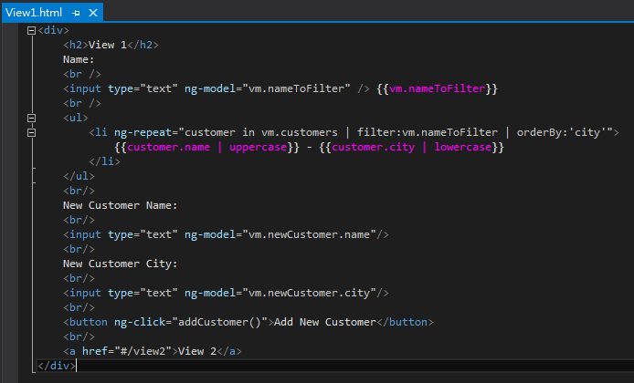
AngularJS Define Routes Demo (step_09_addcustomer)
Demo Page
Copy“Partials_step_08” to “Partials_step_09” & Modify “View1.html”
Binding input to newCustomer
Use “ng-click” to call “addCustomer()” method
Notes:
Here’s an example of a really simple controller called, oddly enough, SimpleController. You’ll notice an interesting thing here in the parameter signature. You’ll see that we pass $scope. This is dependency injection that’s built into AngularJS

Slide 50
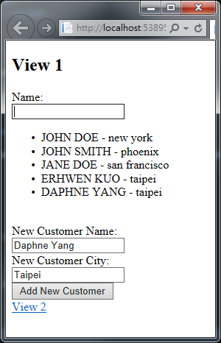
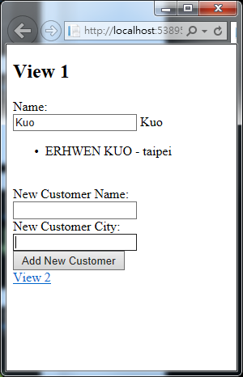
AngularJS Define Routes Demo (step_09_addcustomer)
Demo Page
Select “step_09_addcustomer.html” and Hit “F5” to run

Slide 51
Using Factories and Services
Module
Config
Filter
Directives
Factory
Controller
Service
Routes
Provider
Value
Notes:
最後我們會來看看AngularJS 對於re-use 的概念上的實現。
Another feature of AngularJS is the ability to encapsulate data functionality into factory, services, provider or little value providers.
I’m going to focus on factories here but all three of the top ones shown here – factory, service and providers – they allow us to encapsulate common functionality.
So for instance if I had to go and get customers and I need those customers in multiple controllers I wouldn’t want to hard code that data in each controller. It just wouldn’t make sense and there’d be a lot of duplication there.
Instead what I’ll do is I’ll move that code out to a factory, service or provider.
The difference between the three is just the way in which they create the object that goes and gets the data. That’s really all there is to it.
• With the factory you actually create an object inside of the factory and return it.
• With the service you just have a standard function that uses the this keyword to define function.
• With the provider there’s a $get you define and it can be used to get the object that returns the data.
A value is just a way to get for instance a config value. A simple example of this you’ll see on the Angular site is you might just want the version of a particular script. So you’d have a name-value pair where the name of the value might be “version” and then the value might be say “1.4”
I’m not going to cover all those here but I am going to cover factories. So let’s take a look at how we can use a module to define a factory.

Slide 52
The Role of Factories
Notes:
AngularJS的工廠(factory)必需回傳一個javascript 物件的instance。
AngularJS會確保這個factory方法只會被執行一次然後重覆使用相同一個instance。

Slide 53
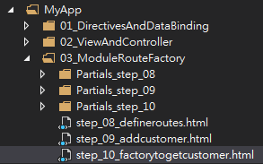

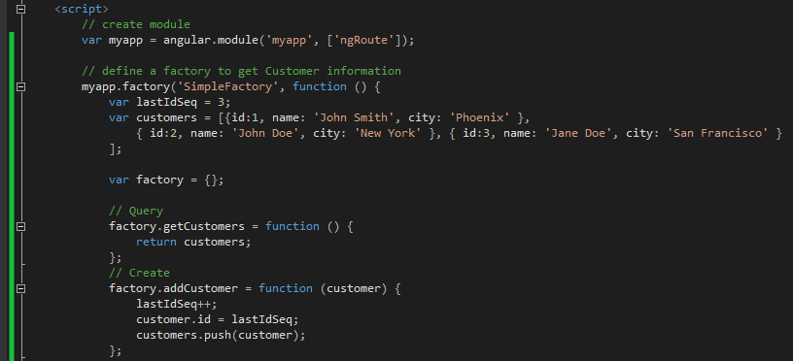
AngularJS Factory Demo (step_10_factorytogetcustomer)
Demo Page
Copy “step_09_addcustomer.html” as “step_10_factorytogetcustomer.html”
Add AngularJS factory “SimpleFactory”
Create a new factory “SimpleFactory“
Define a javascript object instance for return
Define factory own variables and methods for external access
Create a new variable for newCustomer

Slide 54
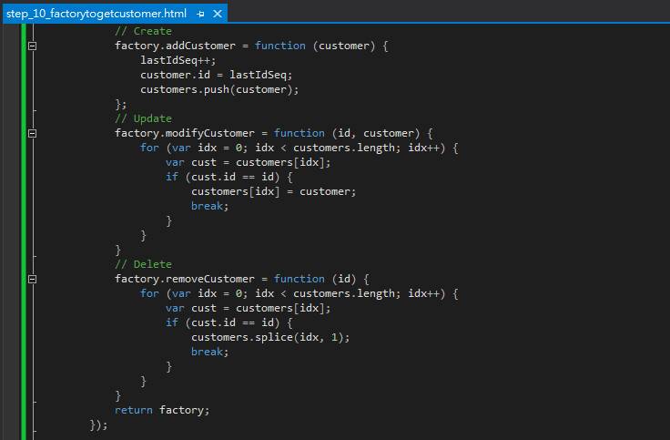
AngularJS Factory Demo (step_10_factorytogetcustomer)
Demo Page
Define factory own variables and methods for external access
Create a new variable for newCustomer
Return javascript object instance

Slide 55
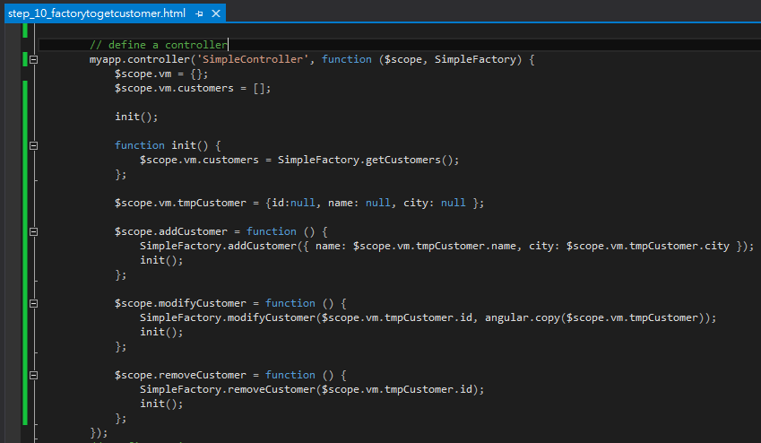
AngularJS Factory Demo (step_10_factorytogetcustomer)
Use “SimpleFactory” to access shared methods or attributes

Slide 56

AngularJS Factory Demo (step_10_factorytogetcustomer)
Config Routings for Create, Update & Delete views

Slide 57


AngularJS Factory Demo (step_10_factorytogetcustomer)
Define Create/Update/Delete View Tempaltes

Slide 58



AngularJS Factory Demo (step_10_factorytogetcustomer)
Demo Page
Select “step_10_factorytogetcustomer.html” and Hit “F5” to run

Slide 59





Next Session: AngularJS with Highchart

